Slide 1

The 23rd Psalm Psalms of Guidance April 10, 2022

Slide 2
Faith – “The Lord is my Shepherd”
Jesus said, “I am the good shepherd …” John 10:11
The church is His flock of sheep. John 10:16; Acts 20:28
Jesus said His sheep hear His voice and follow Him. John 10:27
cf. Romans 10:17, “So then faith cometh by hearing, and hearing by the word of God.”
They do not follow strangers. John 10:5
Is Christ your shepherd and are you following Him?

Slide 3
Assurance – “I shall not want”
cf. 1 Samuel 17:32-37 – David challenging Goliath.
Results from teaching. Psalms 37:23-25; Matthew 6:33
God will supply our needs. Matthew 7:7-8; Hebrews 13:5-6; 2 Corinthians 9:6-11
Hebrews 10:22, “Let us draw near with a true heart in full assurance of faith, having our hearts sprinkled from an evil conscience, and our bodies washed with pure water.”

Slide 4
Contentment – “He maketh me to lie down in green pastures”
1 Timothy 6:6, “But godliness with contentment is great gain.” cf. verses 7-8; Philippians 4:11-13
Failing to be satisfied leads to other sins:
Covetousness. Luke 12:13-15
Envy, jealously, and strife. James 3:14ff

Slide 5
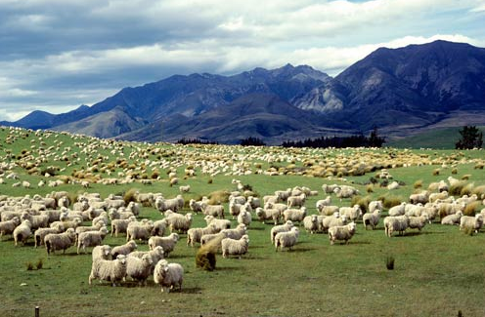
cf. Psalms 65 Praise And Thanksgiving For God’s Abundant Favor To Earth And Man
God’s provisions for His people. Vs. 9-13
Psalms 65:13, “The pastures are clothed with flocks; the valleys also are covered over with grain; they shout for joy, they also sing.” REST. Ezekiel 34:11-16, 23-25
The pastures of the wilderness were the places where flocks
grazed (Luke 15:4; 1 Samuel 25:1-4) – so, when God watered the pastures
abundantly (verses 9-11), the pastures would become clothed with flocks.

Slide 6
Psalms 23
1 The LORD is my shepherd; FAITH I shall not want. ASSURANCE
2 He maketh me to lie down in green pastures: CONTENTMENT he leadeth me beside the still waters. PEACE

Slide 7
Peace – “He leadeth me beside the still waters”
Restless and troubled waters are dangerous. cf. Mark 4:36-41
The still quiet waters are peaceful and safe. Mark 4:38
Living water (everlasting life). John 4:10-14
Jesus is our “Prince of Peace.” cf. Isaiah9:6
Peace is valuable. Philippians 4:7; Matthew 5:9; Romans 14:19; 1 Peter 3:10-12; Romans 12:18; Ephesians 4:1-4
“Let him who thirsts come … whoever desires, let him take the water of life freely” Revelation 22:17

Slide 8
Peace – “He leadeth me beside the still waters”
Not peace at any price!
Put on the whole armor of God. Ephesians 6:10
“Fight the good fight of faith.” 1 Timothy 6:12
Realize it is a spiritual battle. 2 Corinthians 10:3-6
Contend earnestly for the faith. Jude 3
Seek peace from above. James 3:17
Serious consequences. Matthew 10:34

